Slide 1
Optimizing the
Nutrition Care Pathway
Dim3 Platform
Return on Investment for Hospital
Belgium analysis
Baxter Session 13/9/22

Slide 2

Coût global de la malnutrition cliniqque
59%
INCREASED LOS¹
DAYS
UNTREATED MALNUTRITION COSTS
DAYS
€170B
per year in EU²
Augmentation Longueur de Séjour (LOS)
Augmentation cout des services de santé
1. https://clinicalnutritionespen.com/article/S2405-4577(15)00097-2/pdf
2. https://www.nature.com/articles/ejcn2014280

Slide 3












L’Ecosysteme DIM3
360° Clinical Nutrition Management System
ASSESS
Early nutrition risk screening
TREAT
Fast, clinically validated nutrition planning & monitoring
FROM HOSPITAL→ HOME
INFORM
Automated Medical Devices monitoring from hospital to home
Notes:
Dim3 offers expert tools that trigger, assess and sustain a cycle of nutritional well being, improving care, operational efficiencies and reducing costs

Slide 4
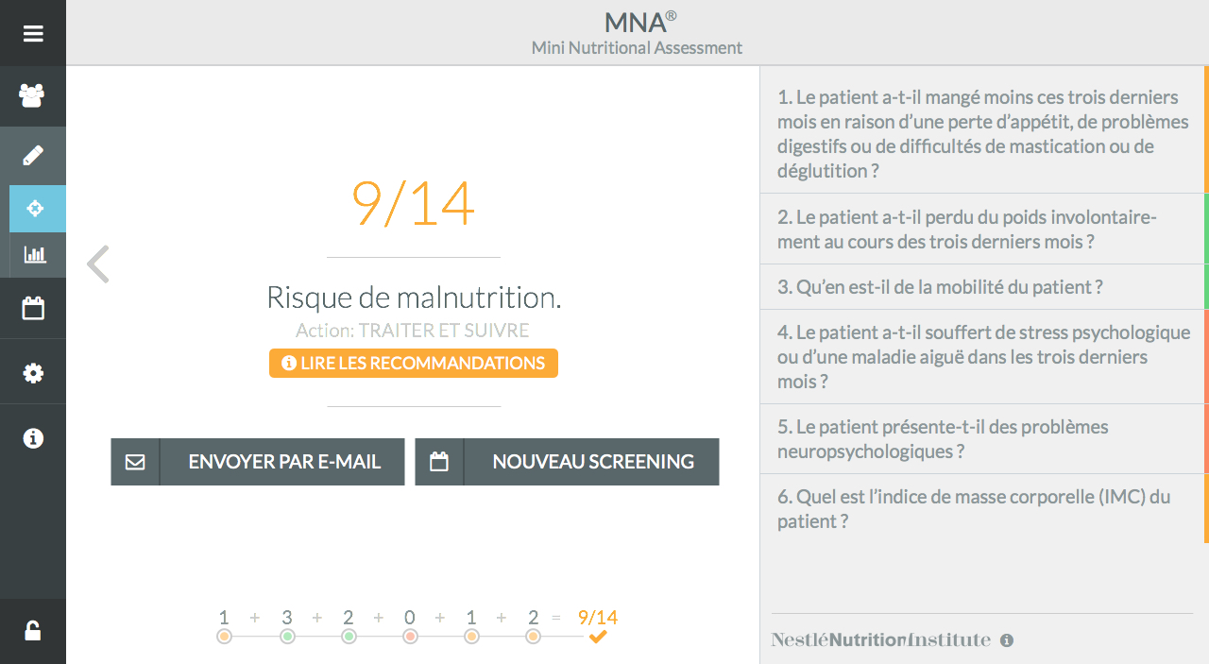
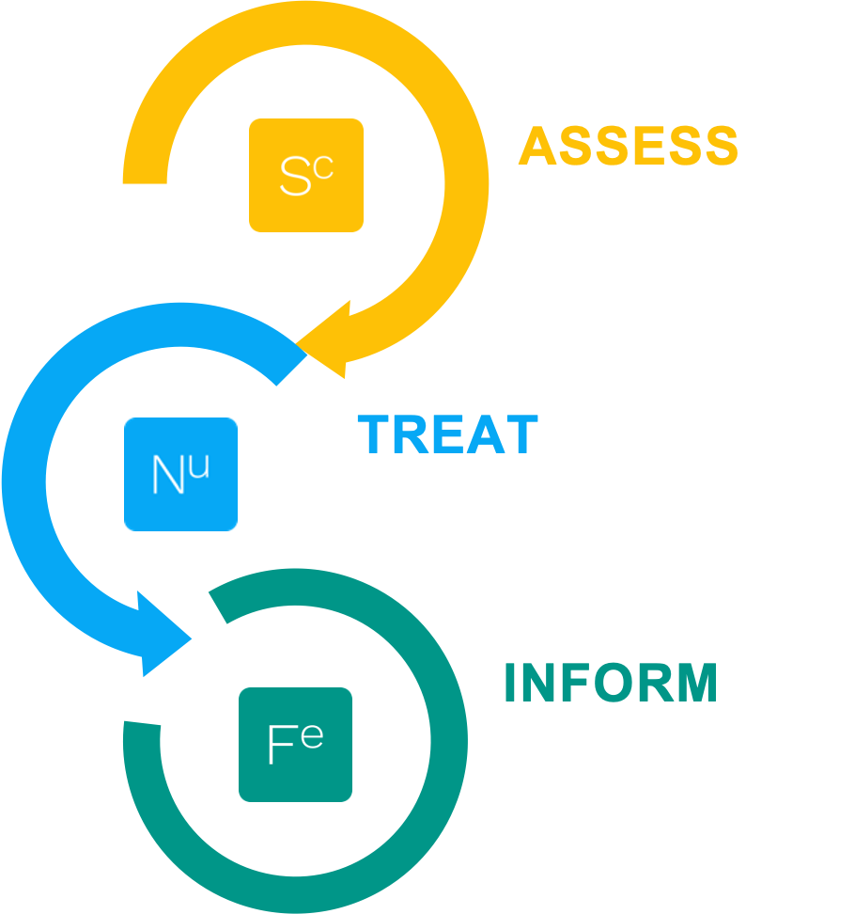

Slide 5
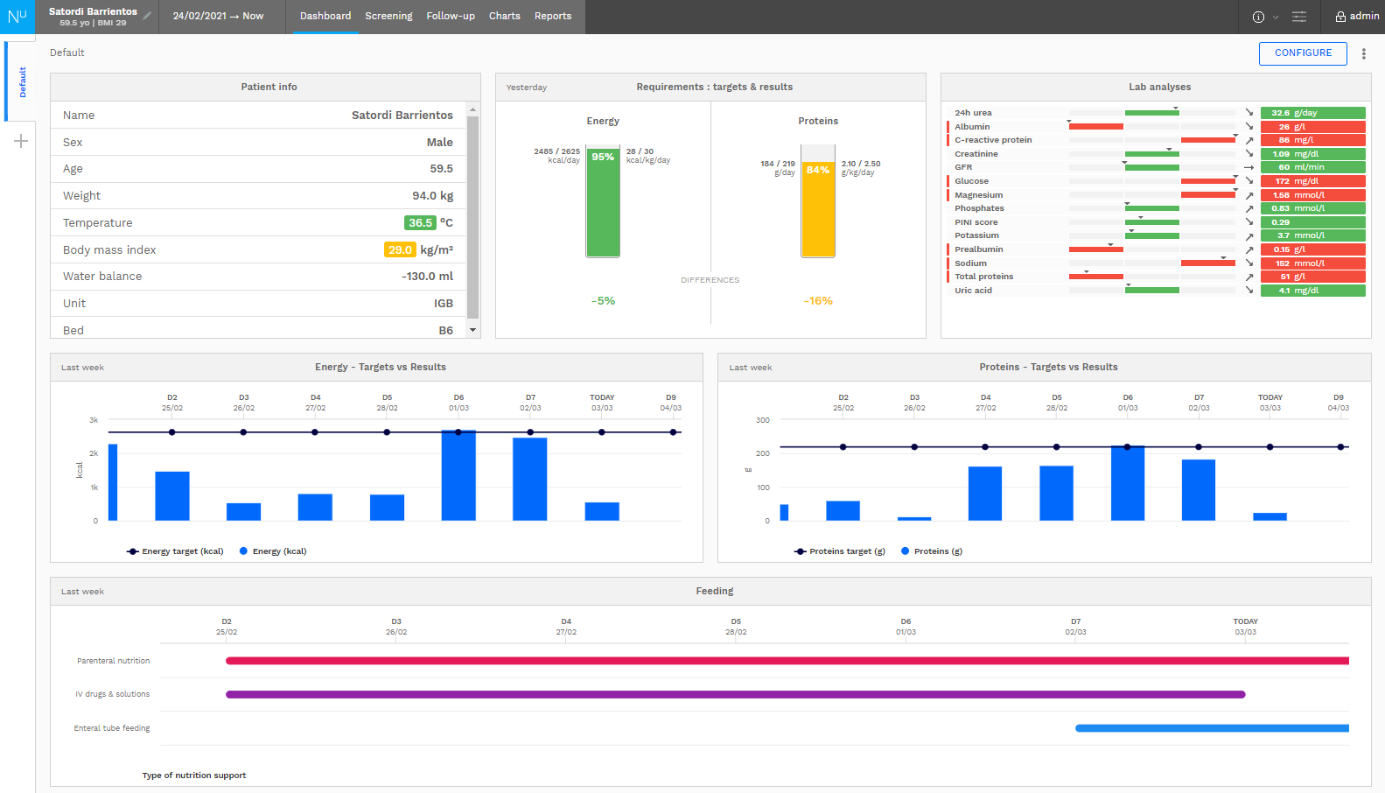

Slide 6


Slide 7
IMPACTS
L’Ecosysteme DIM3
360° Clinical Nutrition Management System
Augmentation compliance nutritionnelle :
De 60% à plus de 90% en entérale
Suivi spécifique patient dans son parcours de soin y compris HAD
Travail d’équipe nutritionnelle plus efficace – temps et gestion
FROM HOSPITAL→ HOME
Tracabilité 100%
Meilleur remboursement par RHM documenté
Qualité percue de l’établissement
Notes:
Dim3 offers expert tools that trigger, assess and sustain a cycle of nutritional well being, improving care, operational efficiencies and reducing costs

Slide 8
Impact of Severity assessment
USING DIGITALIZATION TOOL OF DIM3 ENHANCE REIMBURSMENT & MARGIN
Analysis RCM ERASME
Source Mme Farine Coordinatrice nutritionnelle ERASME
Patients' w / malnutrition
31%
RCM reanalyzed
10 % of hospital stays
can gain in average
1 point of severity
if malnutrition is digitally detected and encoded.
Annual theoretical reimbursement gain
>500 k EUR / yr
Analysis RCM CHC Liège
Source Francoise Martin Coordinatrice nutritionnelle CHC
Patient records reanalyzed
60
Reimbursed days gain
43
Equivalent to an average 0.72 days / hospital stay
Analysis CHU Namur
Source Virginie Vanesse, Chef de service Alimentation Diététique
Patient reports reanalyzed
47
20 with severity increase
43% of stays
Fully revised report with lab data & malnutrition encoding generates a potential gain of
109 days on 47 dossiers
Equivalent to an average
2.3 days / hospital stay
Analysis VIVALIA Group : Hospital with geriatric ward Dr Lemaire RCM director
Patients with a RCM report indicating malnutrition
6%
Versus patients' w/ malnutrition detected by dietician
48%
Annual theoretical reimbursement gain
>350 k EUR / yr
Reimbursment by hospital stay + 1 day (average)
Confidential – Do not copy or distribute

Slide 9


Government Budget for hospitals = 39% financing
Process overview
1
2
ENCODING DEPARTMENT
MINIMAL CLINICAL SUMMARY (RCM in french)
3
GOVERNMENT
DOCTORS
Hospitalized Patient report
EHR
RCM
ICD 10*
GOVERNMENT
TABLES
Severity
Death Probability
+
MND
Mean National Duration Days
REQUEST OF
REIMBURSMENT
TO AUTHORITIES
ELIGIBLE DAYS per PATIENT REPORT
Main Cause of Entry
MALNUTRITION
NOT REPORTED
NOT REIMBURSED
Other Disease conditions
Treatments

Slide 10
Thank you
Optimizing the
Nutrition Care Pathway

Slide 11







The Virtuous Cycle of Better Nutrition
KPI from Scientific Literature and Society Recommendations
BETTER COMPLIANCE
SAVE TIME
REDUCE COSTS
91%
68%
€3.300+
RX calories delivered to patients with computer-based decision support system¹
Less work time per patient with a nutrition management system²
Cost savings per malnourished patient on nutrition-focused program³
https://www.ncbi.nlm.nih.gov/pmc/articles/PMC3667982/
https://pubmed.ncbi.nlm.nih.gov/28975010/
https://www.clinicalnutritionjournal.com/article/S0261-5614(18)30201-2/fulltext

Slide 12



Benefits
Patients
Nutritional Team
Hospital
Homecare Provider
Optimize Tx compliance
Early prevention
Individualized care
Designed to improve outcomes:
  ↑Survival
  ↓ LOS
  ↓ Readmissions
  ↓ Admission to ICU
Optimize workflow & team communication
Centralize patient nutritional status
Reduce errors associated with manual data entry
Simulate optimal nutrition
Adopt clinical guidelines
Support scientific research with structured database
Evidence-based, 1st-class support
Recognized cost savings
Additional revenues by optimally documenting malnutrition
Stimulate interdisciplinary/ inter-hospital dialogue
Concrete building block for JCI/AC or other professional accreditation programs
Better service and support
Service differentiation
  Maximize compliance
  Accuracy of nutrition delivery
  Remote technical assistance
  Reduce unnecessary visits
  Efficient stock management

Slide 13





Root Causes of Malnutrition
Poor Detection
Less than 60% Compliance^{1,2}
Patients at malnutrition risk are not detected or not detected soon enough
Patients don’t receive what they have been prescribed. Very few know the issue
Lack of Knowledge
Multi-step, Disconnected Care
Professionals lack knowledge and sometimes interest in nutrition, resulting in non-optimal practices
Multiple in-hospital transitions, lack of coordination between hospital and home and the trend toward shorter LOS intensifies an issue that is already ill-addressed
1. https://pubmed.ncbi.nlm.nih.gov/19572118/
2. https://pubmed.ncbi.nlm.nih.gov/31684024/

